Slide 1
Commemorative Stamps

Slide 2
What are commemorative stamps?
They are postage stamps which are issued as a special edition to commemorate a cause, person, event or location

Slide 3
Are they rare?
Many postal services all over the world are issued each year
Some postal services issuing hundreds annually
Typically after a year of circulation, the stamps are withdrawn
This creates a limited available supply

Slide 4
Who makes them?
The first commemorative stamp emerged around 1860’s
The design is often executed by an artist who is a citizen of the nation where the stamp is issued
The artist may also make a variety of styles

Slide 5
Most popular stamp
The most popular commemorative stamp ever issued in America was a 1993 Elvis commemorative stamp
124 million copies of the stamp were put away in stamp collections

Slide 7
Many postal services issue a press release at the beginning of the year with a list of the commemorative stamps planned for release that year
Some special unveiling ceremonies may also be held with the stamps being shown to the public at a post office

Slide 10
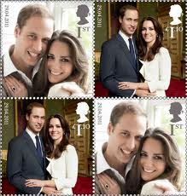

Slide 14
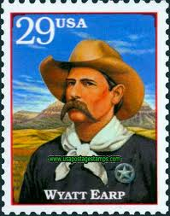

Slide 16
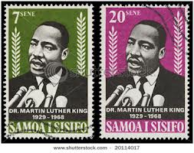

Slide 17
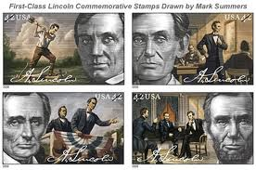

Slide 18
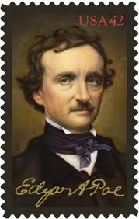

Slide 19
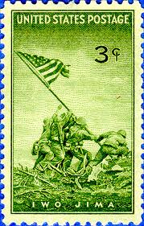

Slide 21
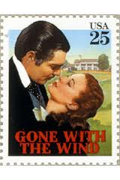

Slide 22
